Slide 1

BANK LOAN ANALYSIS
By Group3

Slide 2

PROJECT DESCRIPTION
We are provided with two datasets (Finance 1& 2) to do the analysis.
The main aim of doing this analysis is to help bank to know whether the business of bank ( i.e. giving loan to the customers) is increasing or not.
Whether the revolving balance credit given by the banks to its customers is being utilized or not.
Or to find out in which states bank is doing good in giving loans.
And also to analyze different payment pattern.

Slide 3
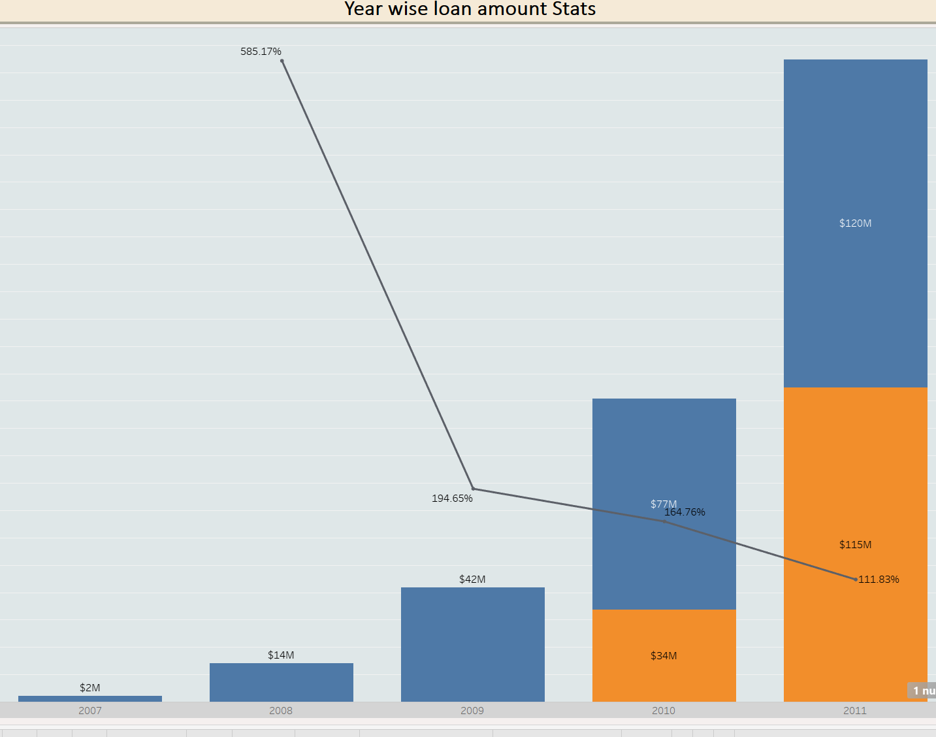
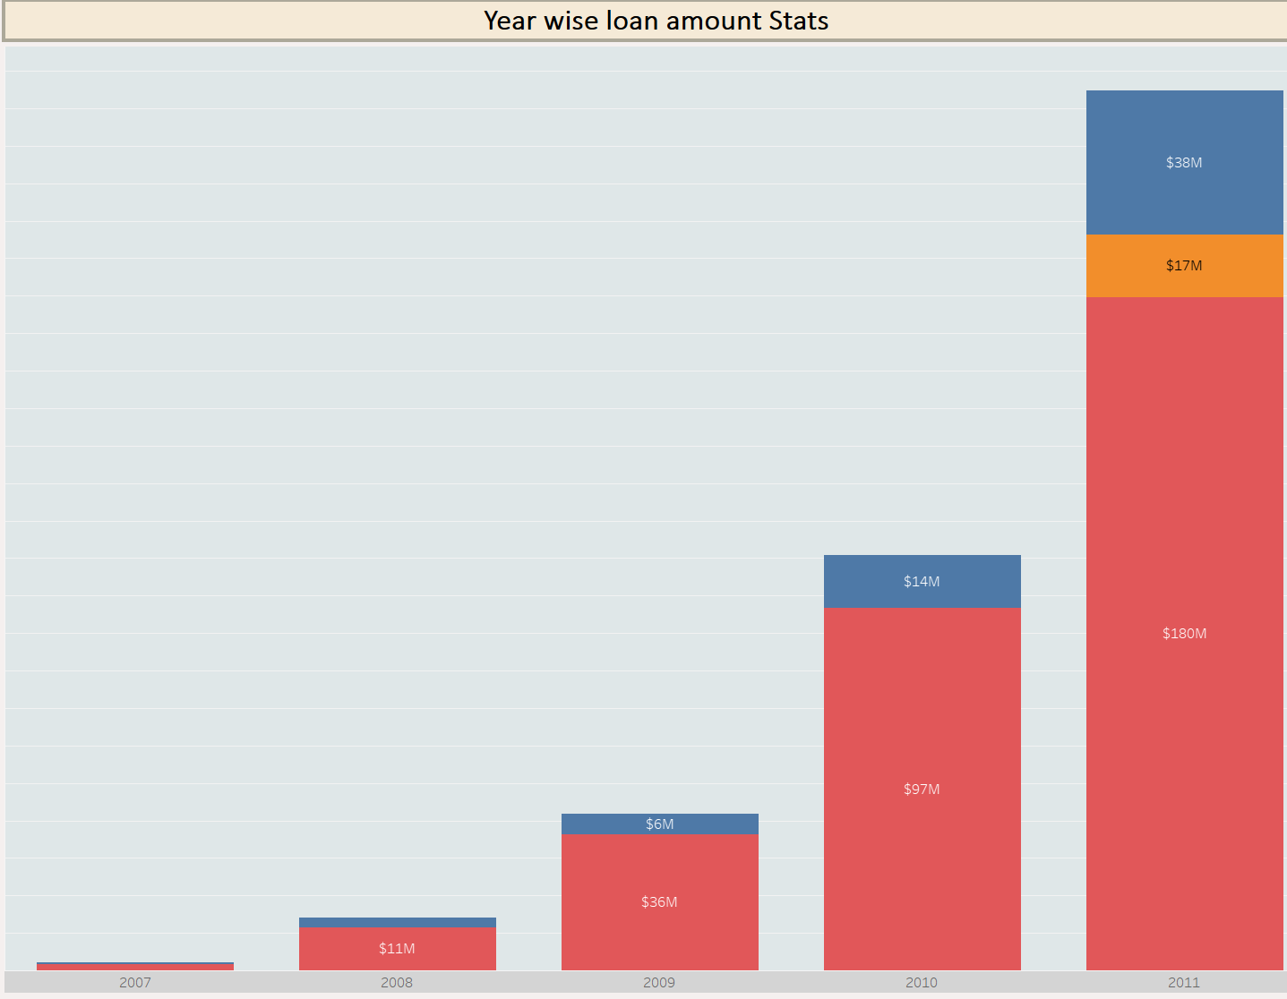
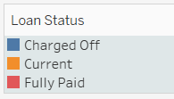

KPI 1: Year wise loan amount Stats
Year Wise & Term Wise Loan Amount and Growth %
Year Wise & Loan-status Wise Loan Amount

Slide 4
Loan amount is the lowest for the year 2007 and highest for the year 2011.
There has been a constant increase in the loan amount.
Most of the loan availed is generally for 36 months term.
OBSERVATION
As most of the loan availed is generally for 36 months term. Bank should try to attract customers for 60 months term loan by offering loans at good interest rate.
Need to focus on attracting more borrowers who are able to repay their loans in full by improving marketing and advertising efforts, or offering more competitive loan terms and interest rates.
Most of the loan given by bank is fully paid but there are also some instances where bank has to charge-off the loan amount, so bank should create some provision or reserve for the situation like this.
SUGGESTION

Slide 5
CONCLUSION
The significant increase in lending activity between 2007 and 2011, along with a focus on both Fully-paid and Charged-off loans, indicates dynamic activity in the company’s lending portfolio during that period.
Most of the loan given by bank are fully paid, which is a good thing.
But the loan which are charged-off is also increasing yearly, it indicates a negative trend.

Slide 6
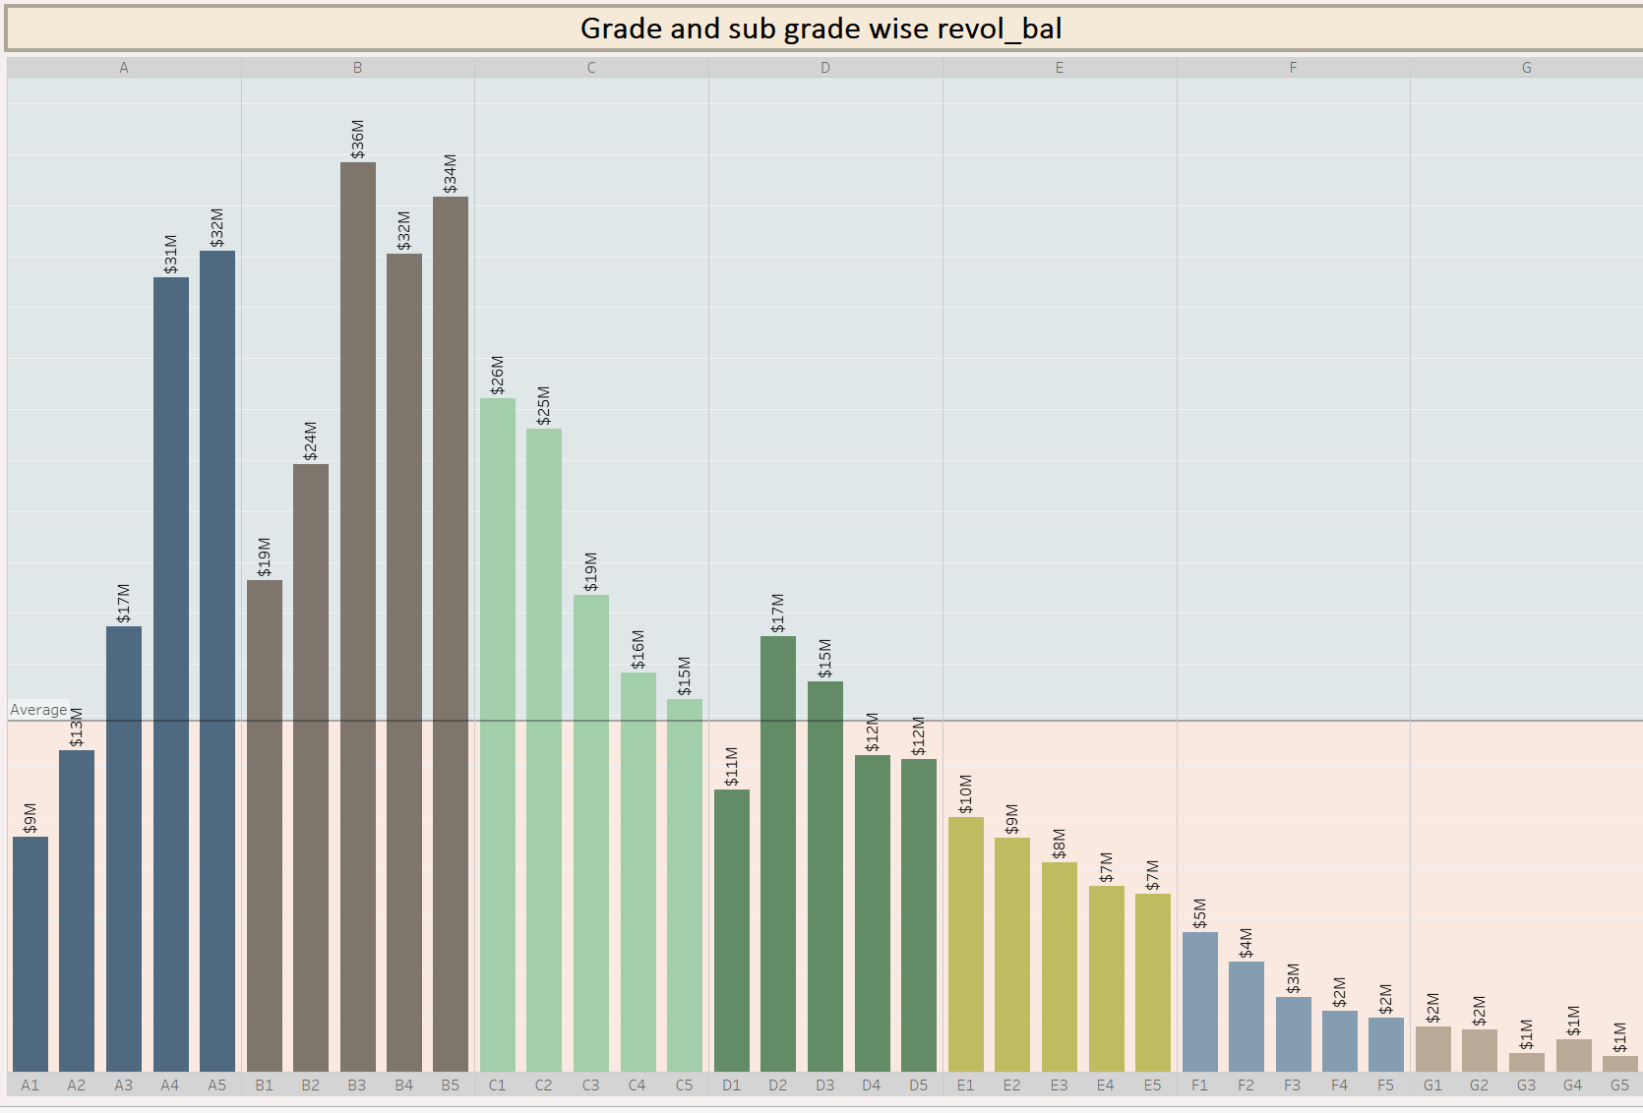
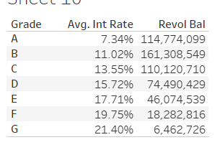
KPI 2: Grade and sub grade wise revolving balance
Grade wise revolving balance and average interest
Grade & Sub-grade wise revolving balance

Slide 7
Grade wise- Grade B has the highest revolving balance whereas Grade G has the lowest revolving balance.
2) Sub-grade wise- Sub-grade B3 ($36M) has the highest revolving balance whereas sub-grade G3 is lowest.
3) Grade E,F and G's revolving balance is lesser than overall average.
OBSERVATION
Provide credit counseling to customers to manage their credit utilization.
And the customers who has utilized the maximum credit balance, banks can offer them some rewards or gifts to retain their customers.
Where average interest rate charged is higher, total revolving balance availed is lesser. So the bank can try to lower the interest rate to increase the revolving balance utilization.
SUGGESTION

Slide 8
CONCLUSION
Individuals or accounts within Category B are utilizing a significant portion of their available credit. Credit utilization is an important factor in credit scoring models, and high utilization can potentially have an impact on credit scores.
Whereas Individuals or accounts within Category G are utilizing a very less portion of their available credit.
Average revolving balance across all the grades is $14M.

Slide 9
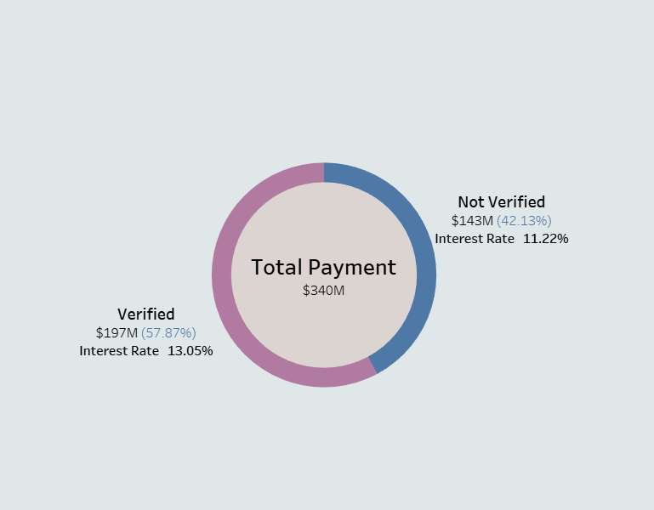
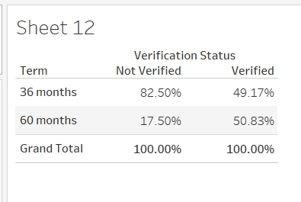
KPI 3: Total Payment for Verified Status & Non Verified Status
Verification Status wise Term wise payment made
Total payment for verified & non-verified status

Slide 10
In total payment, verified clients accounts for 57.87%.
2) Non verified clients usually opted more for shorter period loans (i.e. for 36 months) than the verified clients.
3) Interest charged on verified loans are more than non-verified loans.
OBSERVATION
Banks should focus more on verified clients as they are more secure than non-verified clients.
Due-diligence is a very important thing in a banking sector, so bank must verify their customers before giving loan, as this can impact the profitability of the bank.
Increase efforts to verify loan applicants to increase profitability of the bank. Offer gift vouchers or promotions to encourage customers to apply for verified loans.
SUGGESTION

Slide 11
CONCLUSION
In total payment, payment made by verified clients is higher than non verified client.
It's positive for a bank to have a higher volume of verified loans. This indicates that the bank has successfully processed and approved a significant number of loan applications after thorough verification of the applicants' financial stability.
A higher volume of verified loans generally reflects positively on the bank’s risk management practices and ability to assess and approve loans for individuals or businesses with sound financial profiles.

Slide 12
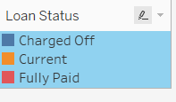
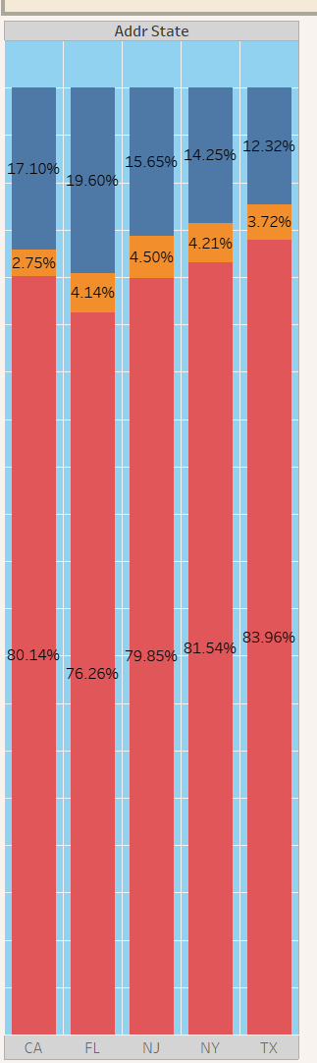
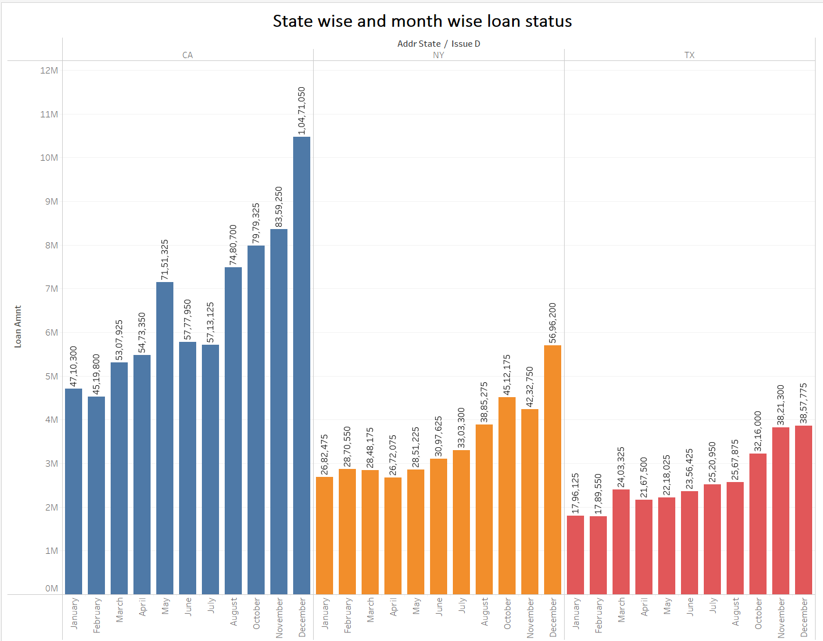
KPI 4: State wise and month wise loan status
State wise month wise loan availed
State wise loan-status wise loan availed

Slide 13
1) Top 3 states according to the total loan amount are-
CA , NY , TX
2) There are some states with relatively low loan amounts, such as IA, ME and NE.
3) We can also observe that loan amount is increasing monthly for most of the states.
OBSERVATION
Loan availed in few states are very less as compared to other state. So banks should try to lure more customers in those states by giving loans at lower interest rate.
By increasing marketing efforts and expanding loan programs in states with lower loan amounts banks can increase their customer-base.
In top 5 states we can notice that almost 80% loan taken are fully paid and rest are charged-off or current, this is a positive trend bank should focus more on recovering the loan amount.
SUGGESTION

Slide 14
CONCLUSION
Number of loans given by bank is increasing monthly.
Most of the loan given are fully paid.
On an average $1M loan is given in all the states.

Slide 15
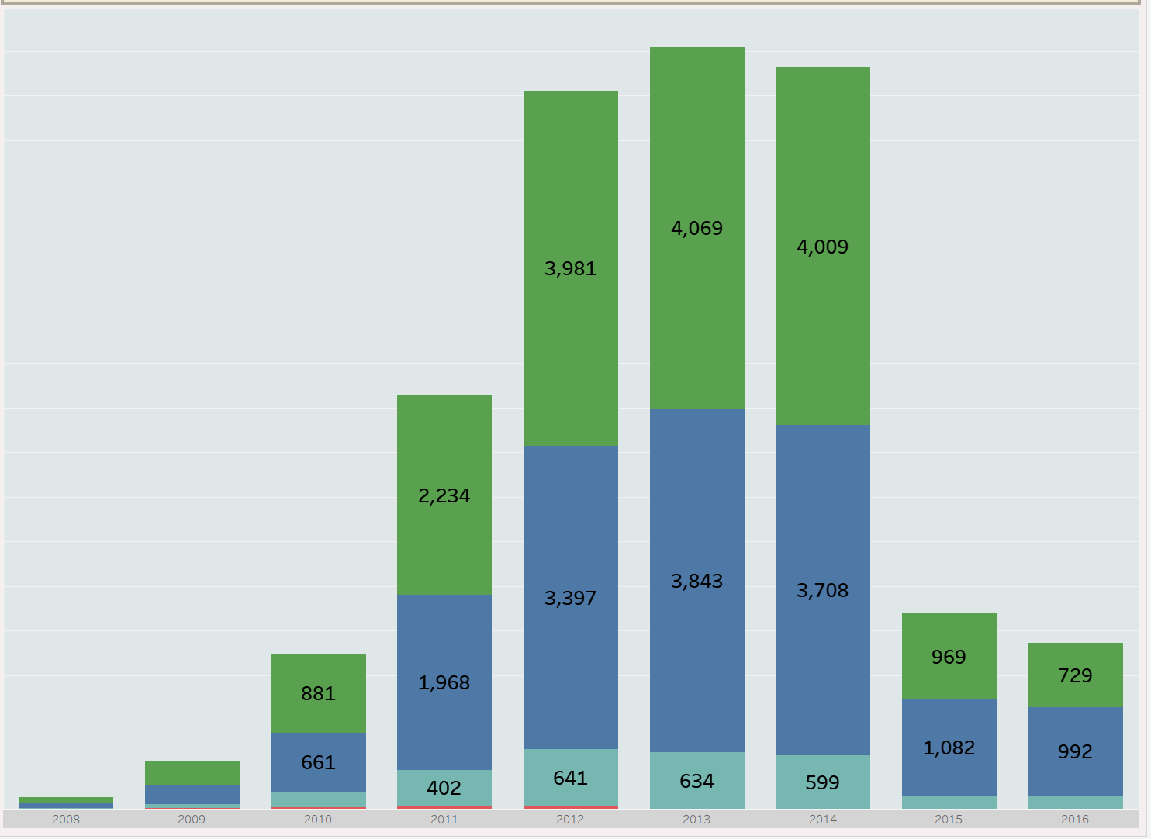
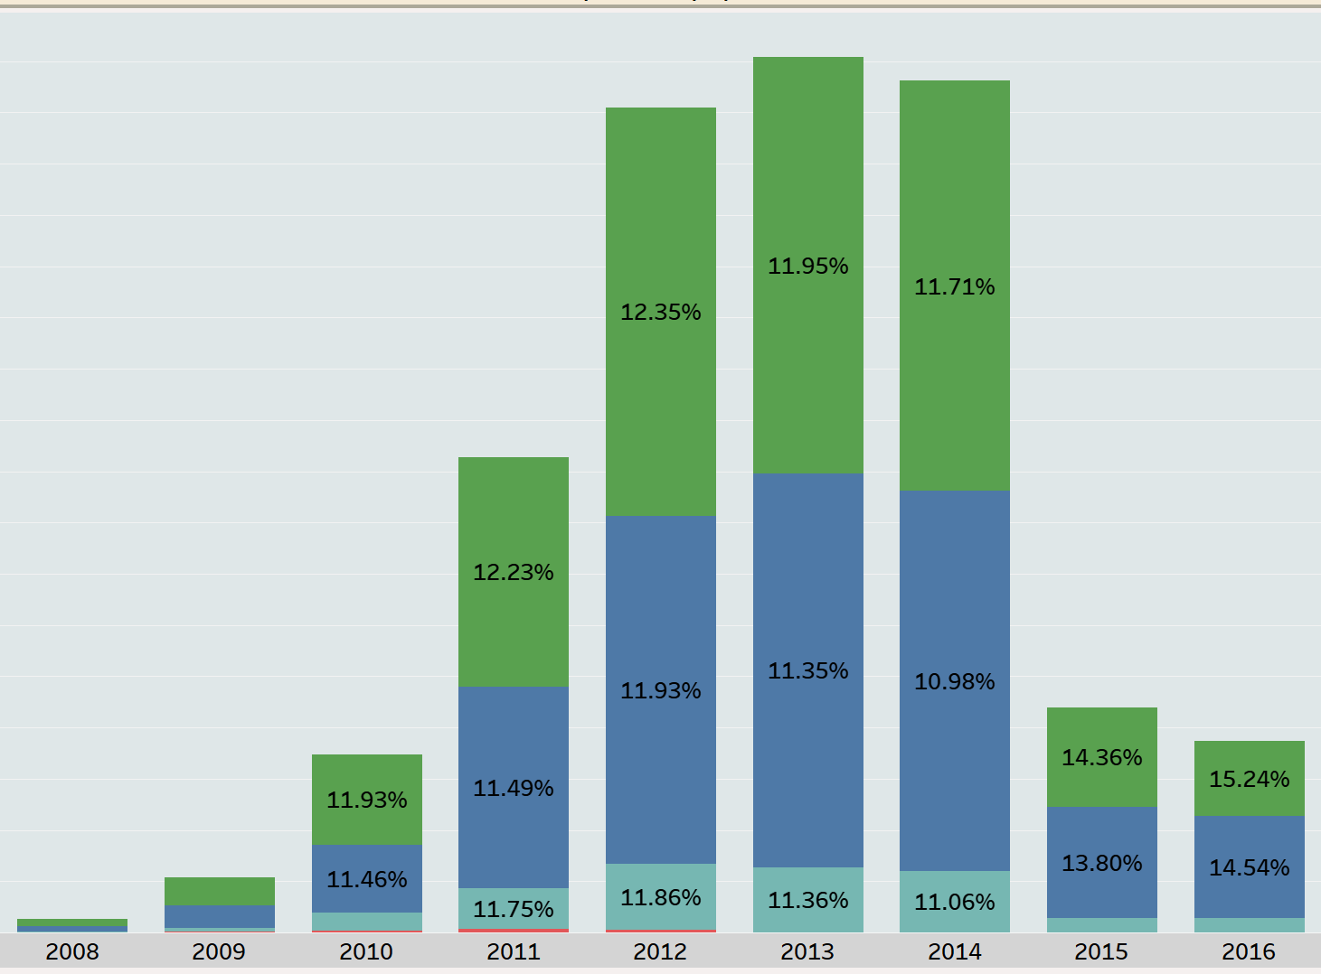
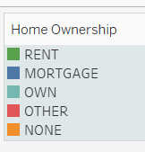
KPI 5: Home ownership Vs last payment date stats
Home ownership wise & last-payment date stats
Home ownership wise & last-payment year wise interest charged

Slide 16
For most of the years, we can notice rent has maximum share, especially for the year 2011, 2012,2013 and 2014.
Share of those people who have mortgaged their houses are also increasing.
For the year 2011-14, we can notice that the people who own house are also increasing.
OBSERVATION
Need to conduct survey for increasing trend of mortgages. This could involve factor like housing affordability, interest rates, and economic conditions.
Year-wise last-payment made by customer is increasing but after the year 2013 it’s showing negative trend, so banks should definitely look into it.
As it is visible from the graph , number of people who made their last payment in the year 2015-16 is very less as compared to others , it might be because the interest charged in the year 2015-16 is higher. So if bank can manage to bring the interest down, people might start paying their payment on time and their will be less chance of default.
SUGGESTION

Slide 17
CONCLUSION
In the year 2012-14, most of the people made their last payment.
The majority of people in this dataset are either renting or have a mortgage.
Overall we can conclude that, there is no significant difference between rented and mortgage housing arrangements during the years 2008-2009. A noticeable increase in the number of people living in rented houses from 2010 to 2014. The trend suggests a shift towards renting rather than owning a house. A gradual increase from 2015 in the number of people with mortgage arrangements. This shift indicates a reversal in the trend from renting to owning, possibly suggesting improved economic conditions.

Slide 18
SUMMARY
Total Customers of the bank is 39,717
Total loan amount given by bank is approx. $404M
Average interest rate charged by bank is 12.03%
Total revolving balance credit given by bank is approx. $532M
The most common purpose for taking loan is debt consolidation.
Number of loans availed for 36 months is higher than number of loans availed for 60 months.
Average annual income of the customers is approx. $69K

Slide 19
OUR TEAM
ANKITA RAI
SANDESHA AMIT SHETE
SANDEEP
SNEHASISH SAHA
SUDHESI DHEVI SAKTHIVEL

Slide 20
THANK YOU

